Slide 1
RSA Protocol (Classical)
-Graeme Jacobson

Slide 2
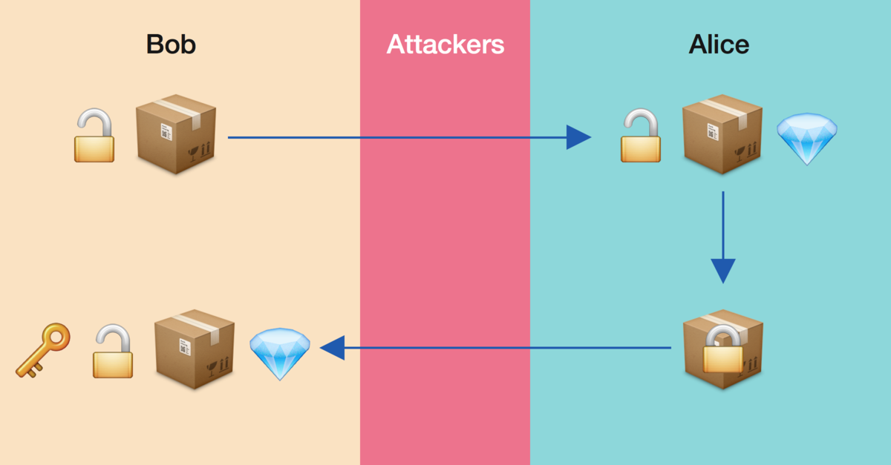
Algorithm
Utilizes Public Key and Private Key
Bob creates public key (padlock) and private key (key to padlock)
Bob gives public key to Alice, attacker can see this
Alice puts message in lock and closes it
Alice sends locked padlock to Bob, attacker can see this
Bob retrieves padlock and unlocks it with private key

Slide 3
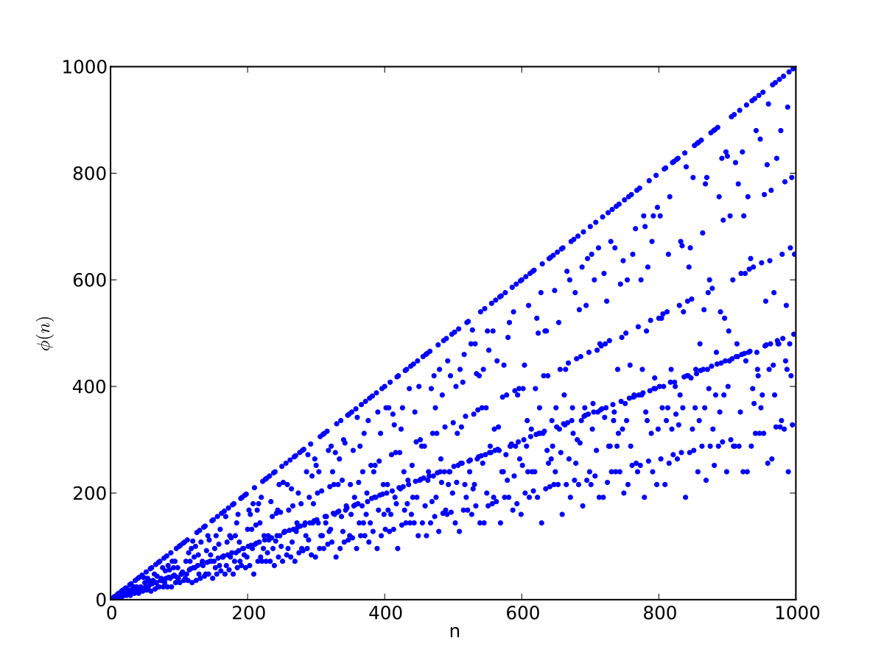
Algorithm Cont.
Bob chooses two random prime numbers p1, p2
Take n=p1*p2
Φ(n) = (p1-1)*(p2-1) , # of ints of n with gcd =1
e, coprime of Φ(n), exponent for encryption
Private key: d for the relationship d*e % Φ(n) = 1
Keep p1, p2, Φ(n), d secure
Public Key: n, e
Encrypted message: c=m^{e} % n
Decrypt message: m=c^{d} % n

Slide 4
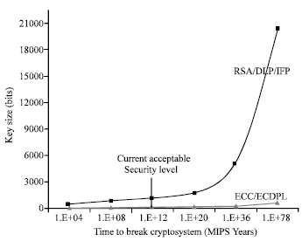
Security of RSA
Exponential increase in time to factor prime numbers
Must factor n in order to find private key
Fastest classical algorithm 2^{O(n^⅓)}
Cannot break encryption due to modulus
Notes:
MIPS- million instructions per second
Only do 2048 bits

Slide 5
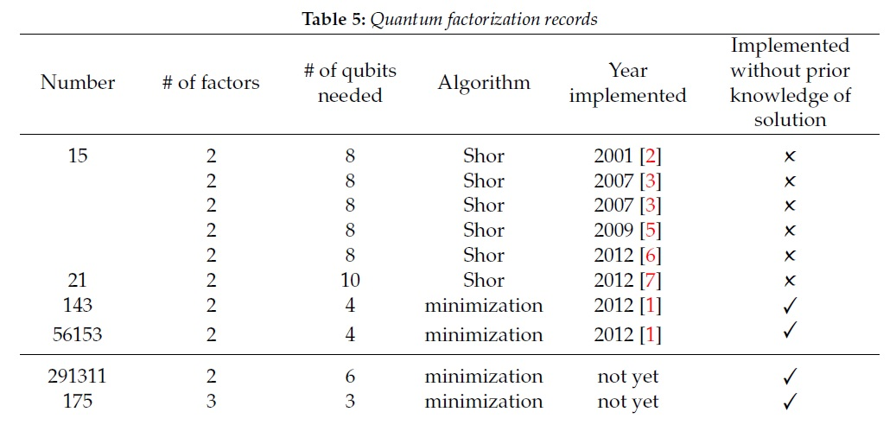
Security of RSA (cont.)
Quantum factoring algorithms pose threat
Shors O(n^3), minimization
Factor RSA with enough qubits
Need ~20 mil qubits for 2048 bits
Notes:
56153 only 16 bits

Slide 6
References
Art of the Problem. (2012, July 30). Public Key Cryptography: RSA Encryption Algorithm [Video File]. Retrieved from https://www.youtube.com/watch?v=wXB-V_Keiu8
Katz, A., Ng, A., & Bourg, P. (n.d.). RSA Encryption. Retrieved September 03, 2020, from https://brilliant.org/wiki/rsa-encryption/
Rabah, K. (n.d.). Review of Methods for Integer Factorization Applied to Cryptography. Retrieved September 13, 2020, from https://scialert.net/fulltext/?doi=jas.2006.458.481
McMahon, D. (2008). Quantum Computing Explained. Wiley-IEEE Press.
Zyga, L. (2014, November 28). New largest number factored on a quantum device is 56,153. Retrieved September 17, 2020, from https://phys.org/news/2014-11-largest-factored-quantum-device.html
Rabah, K. (n.d.). Review of Methods for Integer Factorization Applied to Cryptography. Retrieved September 13, 2020, from https://scialert.net/fulltext/?doi=jas.2006.458.481
ArXiv, E. (2020, April 02). How a quantum computer could break 2048-bit RSA encryption in 8 hours. Retrieved September 17, 2020, from https://www.technologyreview.com/2019/05/30/65724/how-a-quantum-computer-could-break-2048-bit-rsa-encryption-in-8-hours/

